Slide 1
Superstore Sales & Profit Dashboard
Data Analyst Internship – Task 4
Power BI Dashboard

Slide 2
Dashboard Overview
Content:
Interactive Superstore sales and profit dashboard
Key Performance Indicators (KPIs)
Monthly sales trend analysis
Sales and profit by category
Regional sales comparison
Top 10 products by sales
Interactive slicers for Category, Segment and Region

Slide 3
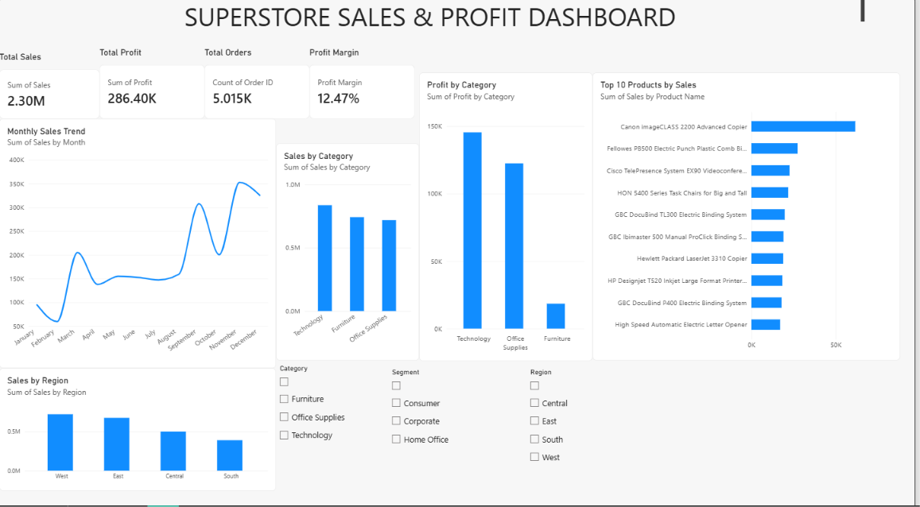

Slide 4
Key Business Insights
Content:
Total Sales: 2.30M
Total Profit: 286.40K
Total Orders: 5.015K
Overall Profit Margin: 12.47%
Technology generates the highest sales and profit among categories.
West region has the highest sales, followed closely by East.
The dashboard identifies the top 10 products by sales for focused business analysis

Slide 5
Tools & Outcome
Content:
Tool: Microsoft Power BI
Dataset: Superstore Sales Dataset
Dashboard: Interactive sales and profit analysis
Key skills: KPI creation, data visualization, slicers, trend analysis and filtering
Outcome: Created a business-focused interactive dashboard to support data-driven decision making

